Slide 1
WELCOME !

Slide 2
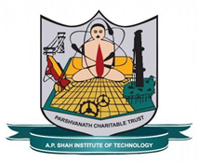
Department of Computer Science & Engineering Artificial Intelligence & Machine Learning
A.P. Shah Institute of Technology, G.B.Road, Kasarvadavli, Thane(W), Mumbai-400615, UNIVERSITY OF MUMBAI, Academic Year 2023-2024

Slide 3
BUS TICKET BOOIKING SYSTEM
Computer Science & Engineering Artificial Intelligence and Machine Learning
By
Sumant Bhise (22106095)
Mithil Bhosale (22106134)
Sumedh Gadpayle (22106076)
Tejas Joshi (22106018)
Under the Guidance of
Prof. Vijaya Bharathi

Slide 4
INDEX
Introduction
Objectives
Features
Literature Survey
Tools/Softwares, Languages Used
Implementation
Conclusion
Reference

Slide 5
INTRODUCTION
A bus reservation system is a software solution designed to provide customers with a personalized easy-to-utilize user experience for booking and purchasing tickets online.
Real-time seat availability, multiple payment gateways, offer seat map functionality, and other features can be implemented.
Millions of people book bus tickets daily to reach destination points (offices, schools, colleges, shopping centers, hospitals, etc).
Large volumes of incoming requests definitely take lots of time to process and confirm by phone, which is when a software solution is required to simplify the process.

Slide 6
Provides 24/7 availability for customers
It allows complete automation of the bus ticket booking process and facilitation of hundreds of daily bookings

Slide 7
OBJECTIVES
Efficiently manage bus seat inventory, ensuring accurate availability data
Implement a system of loyalty rewards to encourage use of public transport
Utilize geolocation services to help users find nearest bus stations and stops
Ensure website compatibility with various web browsers
Enhance data privacy and security measures

Slide 8
FEATURES
Mobile-Friendly Design
Seat Selection
User Registration and Authentication
User Profiles
Integration with GPS and Maps

Slide 9
LITERATURE SURVEY
Online Bus Monitoring and Reservation Application (OBMRA) for GL Trans Agency, Eric A. Paloy, Jayhan C. Sarne, Joseph Christian C. Padin, Mathew Jun P. Mariani.
Development of an Online Bus Ticket Reservation System for a Transportation Service in Nigeria by University of Pretoria, University of Ilorin.
Global Journal of Engineering Sciences and Researches, Bus Reservation System, K. Laxmi Sai Prasanna, K. Shivani, N. Vaishnavi, Ms.P R Anisha, Dr. B V Ramana Murthy & Mr. C Kishor Kumar Reddy.

Slide 10
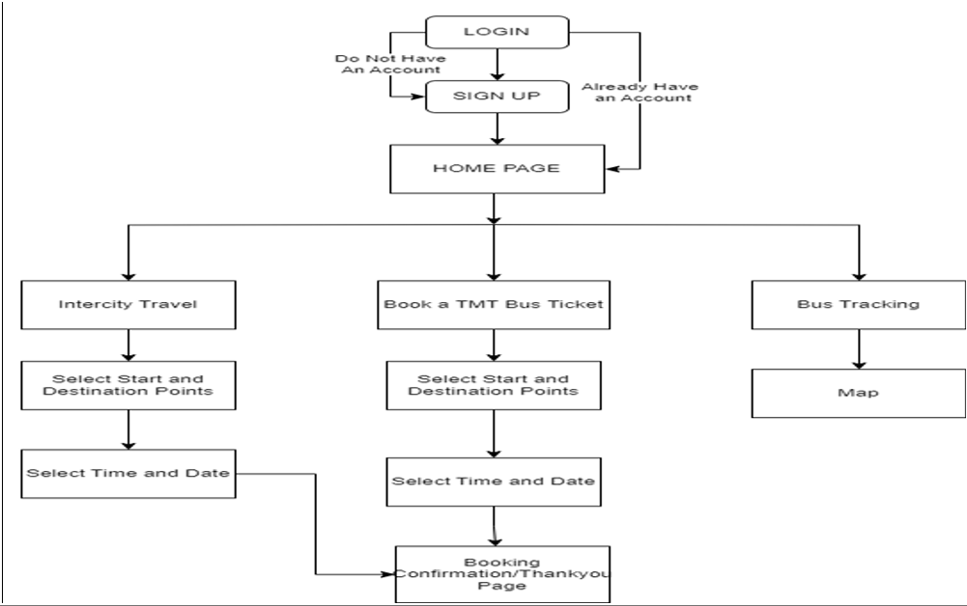
BLOCK DIAGRAM

Slide 11
User is met with a login page/signup page User can select intercity travel, book a TMT bus ticket, or track his/her bus

Slide 12





TOOLS/SOFTWARE , LANGUAGE USED
JAVA SCRIPT
REACT JS
MYSQL
NODE JS
MONGO DB

Slide 13
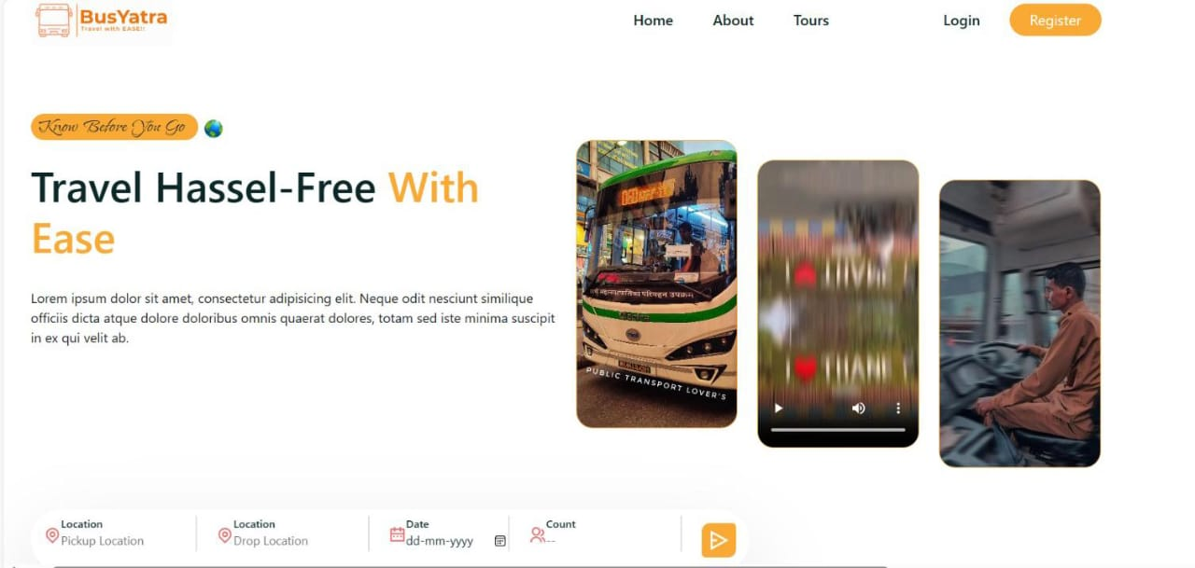
IMPLEMENTATION:

Slide 14
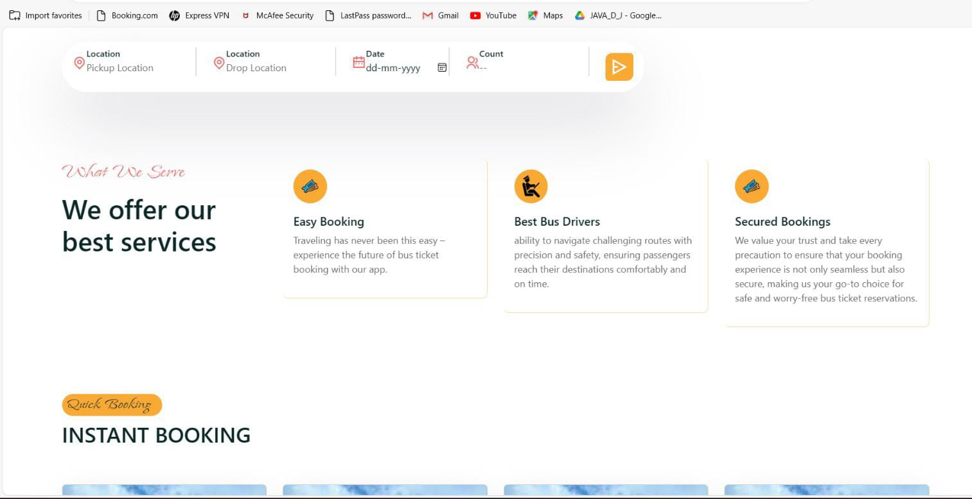
IMPLEMENTATION:

Slide 15
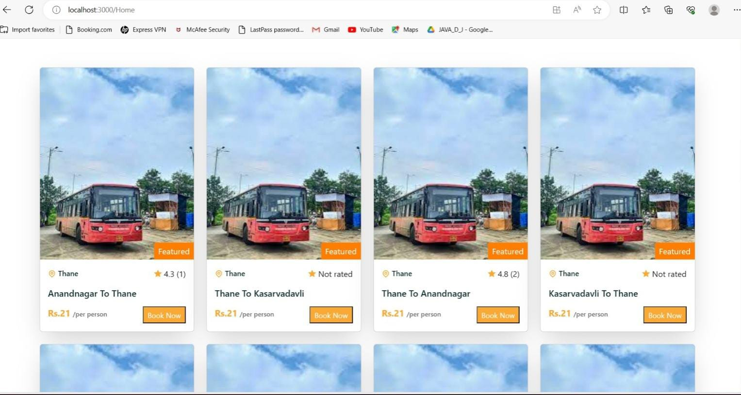
IMPLEMENTATION:

Slide 16
CONCLUSION
The Bus Yatra has successfully addressed the need for an efficient and user-friendly platform for booking bus tickets. Throughout the development process, several key features and functionalities were implemented, including user registration, ticket booking,payment processing and ticket cancellation.

Slide 17
REFERENCES
https://www.redbus.com/
https://chalo.com/
https://www.wikipedia.org/
https://www.youtube.com

Slide 18
THANK YOU !

